Slide 1

Department of ECE
Analog electronic Circuit Design
24ec2104
Topic:
Op-amp with negative feedback_1

Slide 2



AIM OF THE SESSION
This session aims to discuss the significance of negative feedback for Op-Amp.
INSTRUCTIONAL OBJECTIVES
This Session is designed to:
  Understand the advantages of negative feedback.
  Discuss the non-inverting amplifier with negative feedback.
LEARNING OUTCOMES
At the end of this session, you should be able to:
  Understand the working of op-amp with negative feedback
  Calculate and compare the electrical parameters of non-inverting amplifier with and without feedback.

Slide 3
Types of Feedback
If the output signal is fed back to the input either directly or via another network, it is referred to as a circuit with feedback.
If the signal fed back is of opposite polarity or out of phase by 180º, with respect to the input signal, the feedback is called negative feedback. It is also known as degenerative feedback.
If the signal fed back is of the same polarity or in phase with the input signal, the feedback is called positive feedback or regenerative feedback.
Negative feedback is used in amplifier circuits, whereas positive feedback is used in oscillator circuits.
Negative feedback stabilizes the gain, increases the bandwidth, changes the input and output resistances, decreases the nonlinear distortion, and reduces the effect of temperature and supply voltage variations on the output.

Slide 4
Op-Amp with Feedback- Feedback Configurations
A feedback amplifier or a closed-loop amplifier consists of two parts, an op-amp, and a feedback circuit. There are four configurations as listed below:
1. Voltage-series feedback
2. Voltage-shunt feedback
3. Current-series feedback
4. Current-shunt feedback

Slide 5
Feedback Configurations
Feedback Configurations a) Voltage-Series b) Voltage-shunt c) Current-series d) Current-shunt

Slide 6
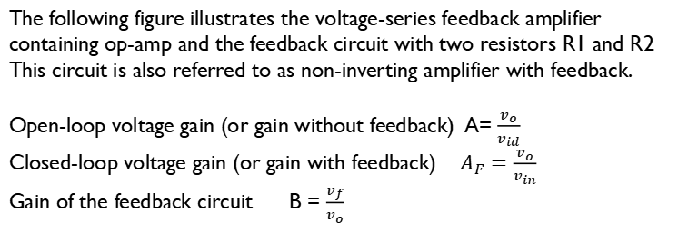
Voltage – Series Feedback Amplifier or Non-Inverting Amplifier with feedback
The following figure illustrates the voltage-series feedback amplifier containing op-amp and the feedback circuit with two resistors R1 and R2
This circuit is also referred to as non-inverting amplifier with feedback.
Open-loop voltage gain (or gain without feedback) A= $\frac{v_{o}}{v_{id}}$
Closed-loop voltage gain (or gain with feedback) $A_{F}=\frac{v_{o}}{v_{in}}$
Gain of the feedback circuit B = $\frac{v_{f}}{v_{o}}$

Slide 7


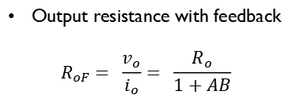
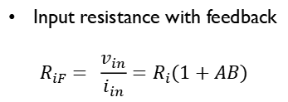

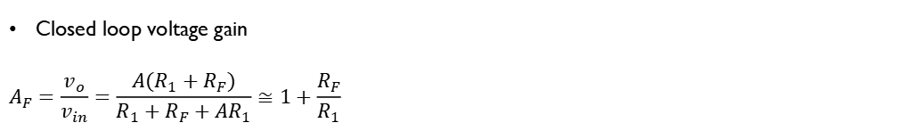
Voltage-Series Feedback Amplifier
Closed loop voltage gain
$$A_{F}=\frac{v_{o}}{v_{in}}=\frac{A(R_{1}+R_{F})}{R_{1}+R_{F}+AR_{1}}≅1+\frac{R_{F}}{R_{1}}$$
Input resistance with feedback
$$R_{iF}= \frac{v_{in}}{i_{in}}=R_{i}(1+AB)$$
$$A_{F}=\frac{A}{1+AB}$$
where AB is the loop gain
Output resistance with feedback
$$R_{oF}= \frac{v_{o}}{i_{o}}= \frac{R_{o}}{1+AB}$$
Bandwidth with feedback
$$f_{F}= f_{o}(1+AB)$$
Total output offset voltage
$$V_{ooT}=\frac{±V_{sat}}{1+AB}$$

Slide 8


Voltage Follower
When the inverting amplifier is configured for unity gain, it is called a voltage follower because the output voltage is equal to and in phase with the input. In other words, in the voltage follower the output follows the input. The voltage follower is also known as non-inverting buffer, as it removes the loading effect when placed between two networks.
$$A_{F}=1$$
$$R_{iF}=AR_{i}$$
$$R_{oF}=\frac{R_{o}}{A}$$
$$f_{F}=Af_{o}$$
$$V_{ooT}=\frac{±V_{sat}}{A}$$

Slide 9


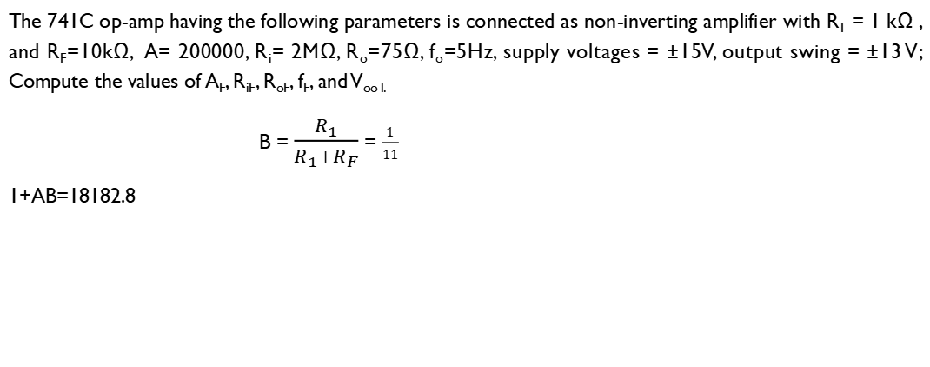
Example
The 741C op-amp having the following parameters is connected as non-inverting amplifier with R₁ = 1 kΩ , and R_{F}=10kΩ, A= 200000, R_{i}= 2MΩ, R_{o}=75Ω, f_{o}=5Hz, supply voltages = ±15V, output swing = ±13 V; Compute the values of A_{F}, R_{iF}, R_{oF}, f_{F}, and V_{ooT.}
B = $\frac{R_{1}}{R_{1}+R_{F}}$ = $\frac{1}{11}$
1+AB=18182.8
$$V_{ooT}=\frac{±V_{sat}}{1+AB}=±0.715 mV$$
$$A_{F}=\frac{A}{1+AB}=10.99$$
$R_{oF}= \frac{R_{o}}{1+AB}=4.12 mΩ$
$$R_{iF}=R_{i}\left(1+AB\right)=36.4 GΩ$$
$$f_{F}= f_{o}\left(1+AB\right)=90.9 kHz$$

Slide 10
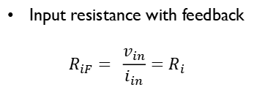
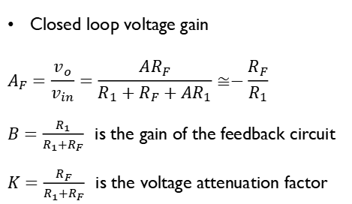
Voltage – Shunt Feedback Amplifier or Inverting Amplifier with feedback
The following figure illustrates the voltage-shunt feedback amplifier and is also referred to as inverting amplifier with feedback.
Closed loop voltage gain
$$A_{F}=\frac{v_{o}}{v_{in}}=\frac{AR_{F}}{R_{1}+R_{F}+AR_{1}}≅−\frac{R_{F}}{R_{1}}$$
$B=\frac{R_{1}}{R_{1}+R_{F}}$is the gain of the feedback circuit
$K=\frac{R_{F}}{R_{1}+R_{F}}$is the voltage attenuation factor
Input resistance with feedback
$$R_{iF}= \frac{v_{in}}{i_{in}}=R_{i}$$
Output resistance with feedback
$$R_{oF}= \frac{v_{o}}{i_{o}}= \frac{R_{o}}{1+AB}$$
Bandwidth with feedback
$$f_{F}= f_{o}(1+AB)$$

Slide 11

SELF-ASSESSMENT QUESTIONS
When negative voltage feedback is applied to an amplifier, its voltage gain ……………….
Is increased
Remains the same
Is reduced
None of the above
The gain of an amplifier with feedback is known as ………….. Gain.
Closed-loop
Open-loop
both
None of the above

Slide 12
SELF-ASSESSMENT QUESTIONS
3. Negative feedback is employed in ……………..
oscillators
amplifiers
comparators
rectifiers
4. For the non-inverting feedback amplifier, the output voltage is…..
In phase with the input
180 degrees out of phase with input
zero
infinity

Slide 13
ANSWERS
c
a
b
b

Slide 14
TERMINAL QUESTIONS
Give two reasons why an open-loop op-amp is unsuitable for linear applications.
List the four negative feedback configurations. Which two are most widely used?
What is the effect of negative feedback in non-inverting amplifiers?
The 741C op-amp having the following parameters is connected as non- inverting amplifier with R₁ = 1 kΩ , and R_{F}=10kΩ, A= 200000, R_{i}= 2MΩ, R_{o}=75Ω, f_{o}=5Hz, supply voltages = ±15V, output swing = ±13 V, UGB = 1 MHz;
Calculate the exact closed-loop gain b) Calculate the ideal closed-loop gain
c) Compare the results of (a) and (b).

Slide 15
REFERENCES FOR FURTHER LEARNING OF THE SESSION
Reference Books:
1. Op-Amps and Linear Integrated Circuit; 4th Ed., Gayakwad, Ramakant A.
Sites and Web links:
https://circuitdigest.com/electronic-circuits/positive-and-negative-feedback-in-op-amp-circuits

Slide 16
THANK YOU
Team – AECD

